Slide 1
Management Concepts

Slide 2
What is Management ???
Is the process of using what you have
{ RESOURCES }, to do what you want to do …. {GOALS}

Slide 3
Definitions
“Management is the art of “knowing what you want to do” and then seeing that it is done in the best and cheapest way.
……F.W. Taylor
“Management is to forecast, to plan, to organise, to command, to coordinate and control activities of others”.
……Henry Fayol

Slide 4
Contd..
Management as a process “consisting of planning, organizing, actuating and controlling, performed to determine and accomplish the objective by the use of people and resources.”
……George R. Terry

Slide 5
Managerial Concerns
  Efficiency
    “Doing things right”
      Getting the most output for the least inputs
  Effectiveness
    “Doing the right things”
      Attaining organizational goals

Slide 6
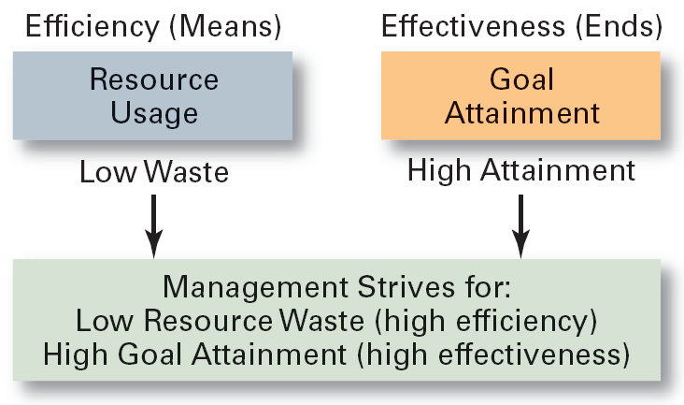
Effectiveness and Efficiency in Management

Slide 7
Nature of Management
Is management an art or science ?
ART: Because it depends on the skills, aptitude & creativity of the manager.
SCIENCE: Because there is considerable knowledge in the field of management with basic principles for guidance of basic activities.

Slide 8
Functions of Management
  Planning
    Defining goals, establishing strategies to achieve goals, developing plans to integrate and coordinate activities.
  Organizing
    Arranging and structuring work to accomplish organizational goals.
  Leading
    Working with and through people to accomplish goals.
  Controlling
    Monitoring, comparing, and correcting work.

Slide 9
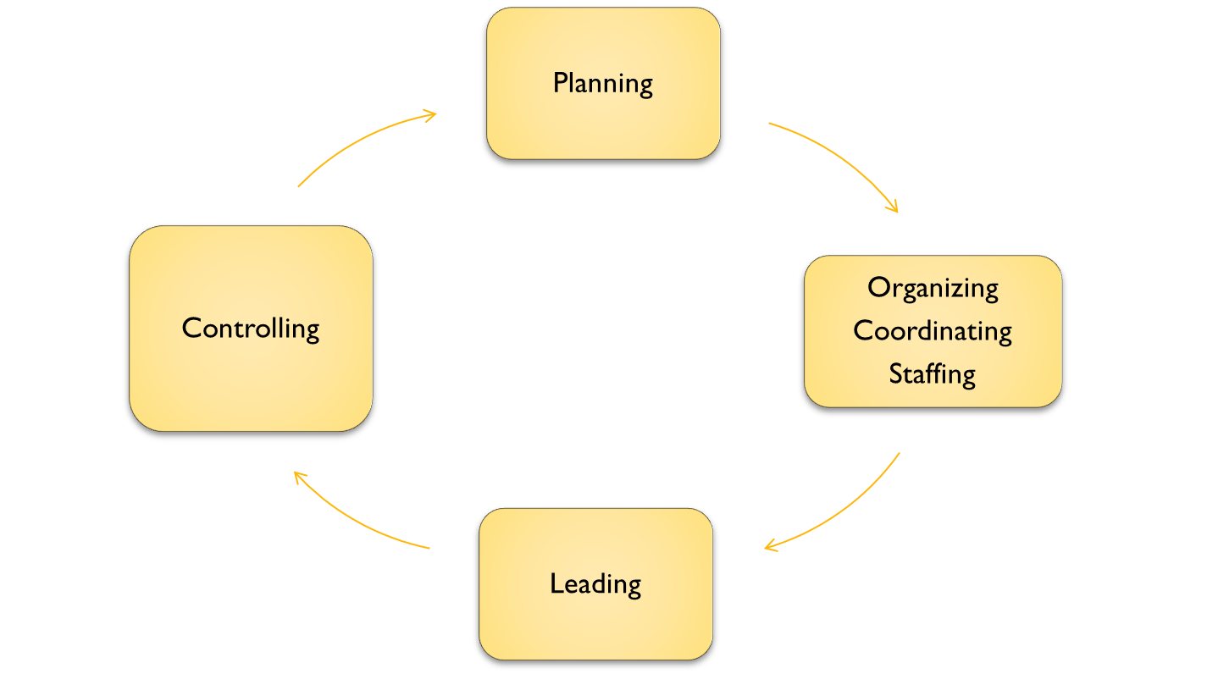
The Management process…..
Revision in plans
Changes in procedures

Slide 10
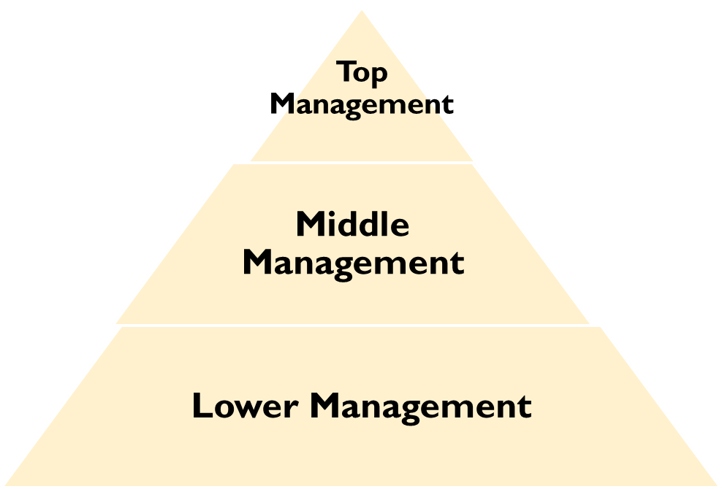
Levels of Management

Slide 11
Administrative
Board of directors CEO
Functional Top Execs ExecssM
Middle Level Execs
First_Line Suupervisors First Line Supervisors
Management

Slide 12
Managerial Skills
Human Skills
Technical Skills
Conceptual Skills

Slide 13

Management Skills
Technical skills
The ability to apply specialized knowledge or expertise.
Human skills
The ability to work with, understand, and motivate other people, both individually and in groups.
Conceptual Skills
The mental ability to analyze and diagnose complex situations.

Slide 14
Conceptual
Human
Board of directors
CEO
Functional Top Executives
Middle Level Executives
First Line Supervisors
Technical

Slide 15
Roles of a Manager
Mintzberg’s Management Roles Approach
  Interpersonal roles
    Figurehead, leader, liaison
  Informational roles
    Monitor, disseminator, spokesperson
  Decisional roles
    Entrepreneur, disturbance handler, resource allocator, negotiator

Slide 16
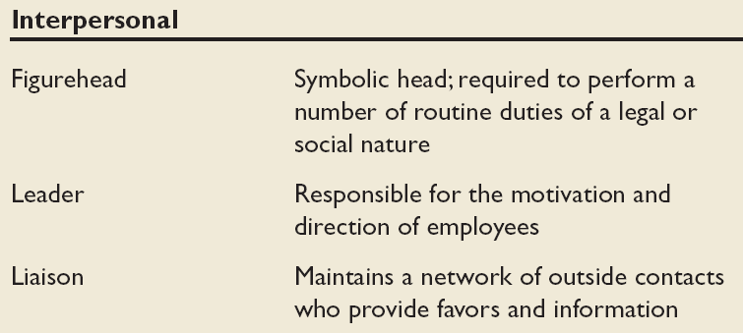
Mintzberg’s Managerial Roles

Slide 17
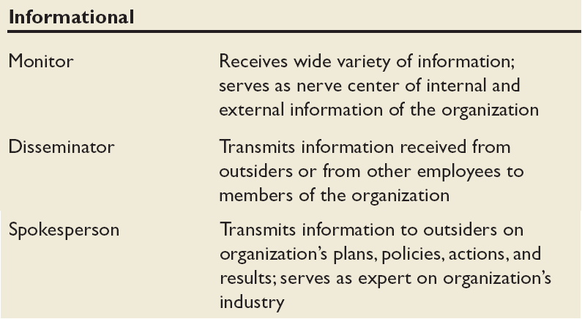

Slide 18
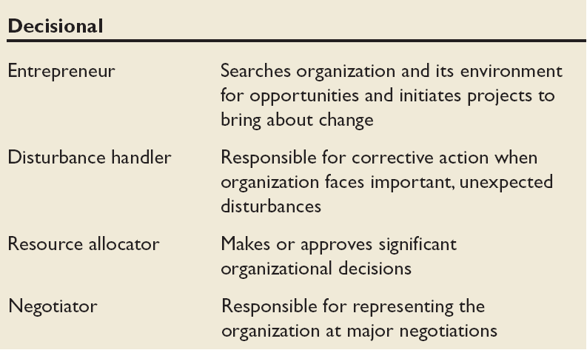

Slide 19
Thank You

